Slide 1

Smart Campus Navigation System using Graphs and Dijkstra's Algorithm
PRESENTED BY:
RISHIK JK (19251052)
GREEN COMPUTING
GUIDED BY :
ALPHONSA J

Slide 2
Abstract
Provides easy navigation inside the campus.
Finds the shortest route between two locations.
Uses Graph Data Structure to represent the campus.
Calculates the best route using Dijkstra's Algorithm.
Reduces travel time inside the campus.
Developed using C Programming.

Slide 3
Key Concepts of the Project
GRAPH | Dijkstra's Algorithm
It stores locations and connections. | It is a shortest path algorithm.
Locations are called Nodes (Vertices). | Finds the minimum distance.
Roads are called Edges. | Takes source and destination as input.
Distances are called Weights. | Checks all possible routes. Selects the shortest route.
It represents the campus map. | Displays the shortest path and distance.

Slide 4
Introduction
Large campuses contain many buildings.
New students often get confused.
Finding classrooms takes extra time.
Manual navigation is not always easy.
A digital navigation system can solve this problem.
This project provides a simple navigation solution.

Slide 5
Literature Review
Navigation systems are used in schools, colleges, and cities.
Graphs are commonly used to represent maps.
Every location is treated as a node.
Roads are represented as edges.
Dijkstra's Algorithm finds the shortest route.
Many navigation applications use similar concepts.

Slide 6
Objectives
Create a campus navigation system.
Store all campus locations.
Connect locations with road distances.
Find the shortest route.
Display total distance.
Improve navigation efficiency.

Slide 7
Problem Statement
Students waste time searching for classrooms.
Visitors do not know campus routes.
Choosing the wrong path increases travel time.
Existing navigation methods are manual.
A faster route finding system is needed.
The project helps users reach destinations easily.

Slide 8
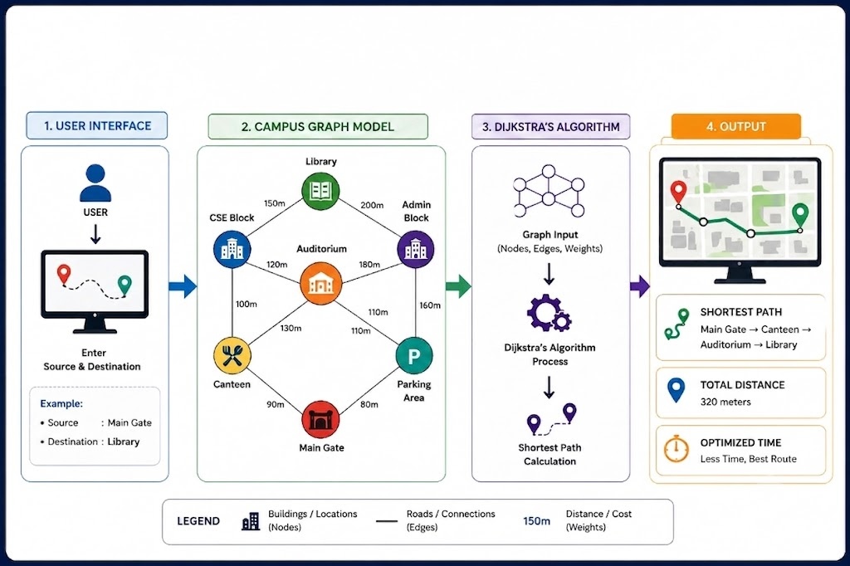
Architecture Diagram

Slide 9


